Slide 1
3D Printing Parameter Optimisation: Impact of K-Value on Carbon-Reinforced PETG
Supervisor: Oana Istrate
Meeting #: 7 Date: 20/08/2026
MEE7012-SUM
Name: Vipul Kohinkar

Slide 2
Aims & Objectives
Aim
To investigate the effect of K value (flow rate multiplier) on the structural and mechanical properties of FDM-printed PETG and carbon-reinforced PETG (CF-PETG).
Objectives
3D print ISO 527-2 Type 5A PETG and CF-PETG specimens at the different K-values using the Ultimaker S5.
Perform tensile testing on all specimens using tensile testing machine in accordance with ISO 527-2 and determine tensile strength, Young's modulus, and elongation at break for each material and K-value.
Conduct optical microscopy to investigate surface quality and visible defects in the printed specimens.
Compare the mechanical performance of PETG and CF-PETG across all K-values.
Begin report writing by preparing the report subsection outline and the Materials section for the project checkpoint.

Slide 3
Project timeline / Gantt
Results analysis and report writing in progress.

Slide 4
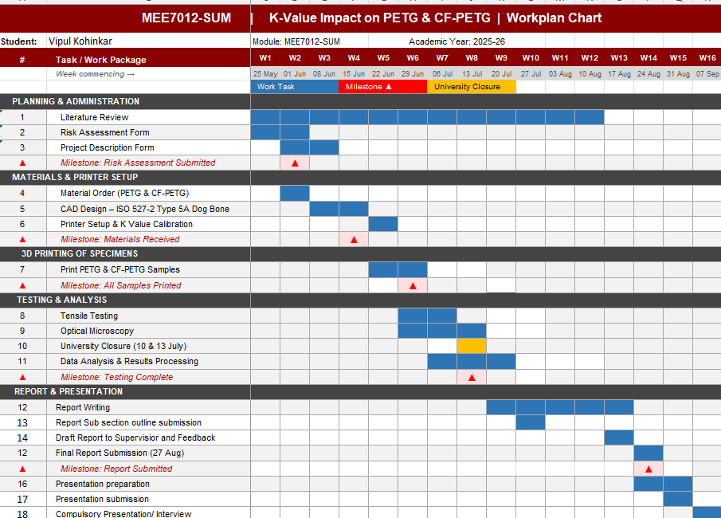

Slide 5
Background – key literature
Carbon fibre reinforcement improves the stiffness and mechanical performance of PETG composites compared with unreinforced PETG (Kichloo et al., 2022).
Mechanical properties of CF-PETG are significantly affected by process parameters including print speed, layer height, raster angle, infill density, and build orientation (Patel et al., 2024)(Economides et al., 2024).
Alarifi (2023) found that specimen structure and manufacturing conditions influence the tensile behaviour and failure characteristics of PETG/CF composites.
Balasrinivasan et al. (2024) reported that feed rate and infill pattern have a measurable effect on the tensile performance of PETG-CF specimens.

Slide 6
Background – key literature
Lendvai et al. (2024) reported that adjusting the filament extrusion multiplier/flow rate (k = 0.97 to 1.05) during Material Extrusion of PLA minimizes internal voids, but over-extrusion forces excess material to the sides, reducing geometric accuracy and decreasing tensile strength.
Minaoglou et al. (2024) found that increasing the material flow rate (85% to 115%) significantly improves interlayer bonding and ultimate tensile strength in CF-PETG processed via FFF.
Gao et al. (2026) used a wide combination of settings including flow rates of 95%, 100%, 105%, and 110% to show how flow rate works alongside temperature and speed to dictate layer bonding and final strength in FDM printed PLA-CF parts.
Modifying the material flow rate (90% to 110%) controls the road width and geometric profile of the tracks, altering the surface roughness of FDM printed PETG components (Barrios and Romero, 2019).

Slide 7
Background – key literature
Rihar and Hozdić (2026) investigated PETG and CF-PETG tensile behaviour using specimens designed according to ISO 527-2:2012 and showed that increasing infill density reduced porosity and improved tensile strength, supported by optical microscopy.
Gomez-Ortega et al. (2024) reported that wall thickness, nozzle temperature and infill density significantly influence the tensile properties of PA-CF, with porosity and interlayer bonding identified as the main factors governing tensile performance.
Jamal et al. (2024) concluded that layer height, nozzle diameter, print temperature, fibre orientation and infill design are the most influential printing parameters controlling the tensile behaviour of fibre-reinforced FDM composites.
Kargar and Ghasemi-Ghalebahman (2023) demonstrated that raster angle, infill density, nozzle diameter and layer thickness significantly affect the tensile strength and fatigue life of FDM-printed CF-PLA.

Slide 8
Background – key literature
Rogelj et al. (2025) reported that layer height (0.2mm to 0.4mm) and perimeter wall count directly govern contact area and thermal bonding, significantly altering the tensile performance of FFF carbon fiber composites tested under ISO 527-2.
Megersa et al. (2024) utilized (PLA) ISO 527-2 Type 5A dogbone specimens to evaluate how layer thickness, build orientation, and raster alignment dictate ultimate tensile strength and elastic modulus.
Szust and Adamski (2022) analyzed FDM-printed PETG and PLA ISO 527-2 specimens across multiple build orientations, finding that reducing layer height from 0.24mm down to 0.12mm increases transverse Z-axis tensile strength by up to 71% due to enhanced interlayer adhesion.
Stojković et al. (2023) evaluated FDM 3D-printed PLA, PETG and PETGCF to analyze how varying layer height (0.1mm, 0.2mm and 0.3mm) affects tensile strength, proving that reducing layer thickness consistently increases tensile strength across all tested materials due to improved thermal diffusion and interlayer bonding.

Slide 9
Background – key literature
Ekşi and Karakaya (2025) investigated FDM of PLA specimens printed according to ISO 527-2 Type B, proving that infill percentage is the most dominant factor for tensile strength whereas layer thickness (0.2mm to 0.6mm) controls maximum elongation at break.
Szykiedans et al. (2017) evaluated FDM-printed neat PETG and Glass Fiber-reinforced PETG (Z-GLASS) comparing standard ISO 527-2 Type 1A and Type 5A dogbones, demonstrating that upright (Z-axis) orientation suffers severe inter-layer delamination, whereas flat orientation captures full tensile modulus and raster-alignment effects.
Albaşkara and Yıldız (2025) showed that vertical build orientation causes material-dependent failure under Z-axis tension: PLA exhibits brittle inter-layer failure, ABS loses strength and PETG shows superior inter-layer fusion, achieving peak ductility and high strength.

Slide 10
Background – key literature
Ahn et al. (2002) investigated the anisotropic behaviour of FDM-manufactured ABS components, demonstrating that raster orientation and build direction significantly influence tensile performance due to the directional deposition of material and inter-layer bonding characteristics.
Torrado Perez et al. (2014) evaluated tensile specimens manufactured in different print orientations and showed that build orientation strongly affects mechanical properties and fracture behaviour, with orientation-dependent anisotropy observed in strength, ductility and failure mechanisms.
Domingo-Espin et al. (2015) characterised FDM-printed polycarbonate specimens produced in multiple build orientations, confirming that part orientation is one of the most significant factors affecting mechanical behaviour, stiffness and strength due to the anisotropic nature of layer-by-layer fabrication.

Slide 11
Background – the gap
Previous studies on PETG and CF-PETG have focused mainly on print temperature, speed, and layer height, with limited attention given to K value.
Carbon fibre reinforcement alters melt viscosity and extrusion behaviour, suggesting that a different optimum K value may be required compared with neat PETG; however, this has not been experimentally validated.
The mechanical effects of under-extrusion and over-extrusion on tensile performance remain unquantified.
This project addresses the gap by evaluating four K values for PETG and CF-PETG using ISO 527-2 tensile specimens to identify the optimum K value for each material.

Slide 12
Background – the gap
Recent studies have primarily examined surface characteristics in PETG and tensile properties in CF-PETG. As a result, the influence of flow rate on void formation and mechanical performance in CF-PETG remains unclear.
Studies have also shown that increasing flow rate can improve interlayer bonding and reduce porosity; however, excessive flow may lead to dimensional inaccuracies and surface defects.
Furthermore, no reviewed study has directly compared neat PETG and CF-PETG under identical flow-rate (K-value) conditions.

Slide 13
Background – the gap
Recent studies have demonstrated that wall thickness, raster angle, infill density, nozzle diameter and printing temperature significantly influence the tensile behaviour of FDM-printed carbon fibre-reinforced composites.
The reviewed papers investigate combinations of printing parameters, such as raster angle, wall thickness, infill density and nozzle temperature, making it difficult to identify the individual effect of a single parameter on tensile performance.

Slide 14
Background – the gap
While prior literature extensively evaluates how layer thickness, build orientation, and perimeter counts influence mechanical strength, these works analyze variables independently or focus on isolated parameters without a unified comparative framework.
Furthermore, while existing research provides valuable tensile data on standardized dogbone specimens for neat thermoplastics, there remains a distinct absence of literature directly comparing how volumetric flow rate adjustments and material reinforcement interact under identical testing conditions.

Slide 15
Progress to date
Initial supervisor and co-supervisor meetings completed, establishing the project scope and experimental test matrix (56 specimens: 4 K values × 7 repeats × 2 materials).
ISO 527-2 Type 5A selected as the specimen standard for tensile testing, enabling direct comparison with published literature.
Risk assessment submitted and approved by the School Health & Safety Coordinator.
Material requisition approved for PETG and CF-PETG Carbon-P, both 2.85 mm filament for the Ultimaker S5; delivery confirmation pending.
Meeting completed with laboratory technician to discuss Ultimaker Cura, Ultimaker S5 operation, material requirements, and specimen manufacturing procedures.

Slide 16
Progress to date
Submitted and approved the manufacturing requisition form.
Received and collected the PETG and CF-PETG filaments, handed them over to Troy for drying.
Checked machine availability with Troy and secured lab slots for this Thursday and Friday.
Collected the required PPE kit and met with Katie to discuss upcoming tensile testing and microscope procedures.

Slide 17
Progress to date
Completed 3D printing of all 56 tensile specimens
Submitted the material testing request form for tensile testing.

Slide 18
Progress to date
Project checkpoint task nearing completion.
Material testing lab was booked for 23 July for training.

Slide 19
Progress to date
Tensile testing completed for PETG and CF-PETG specimens across all flow conditions.
Project Progress Checkpoint Report Submitted

Slide 20
Challenges & questions
Printing consistency: Ensuring all 56 specimens are manufactured under identical conditions so that Flow (%) remains the only experimental variable.
Lab availability: Getting timely access to the 3D printer, tensile tester, and microscope.
One specimen was damaged during removal from the build plate.
Selection of a suitable printing parameter for the second print set.
Issues generating pull-to-break graphs in RStudio.
Checking unusual modulus result for Set-2 PETG 110% Flow Sample 1.

Slide 21
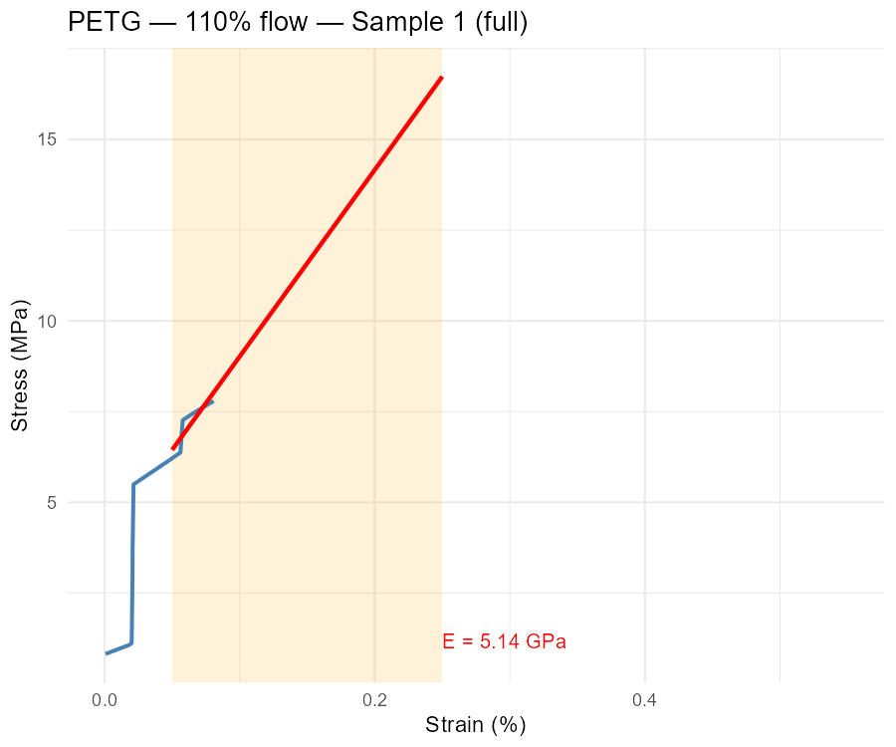
Challenges & questions

Slide 22
Future plan
Complete graph replotting and image processing.
Complete report writing and dissertation submission.

Slide 23
Safety & risk considerations
Project risk assessment submitted and approved by the School Health & Safety Coordinator.
Control measures include laboratory induction, compliance with Ultimaker S5 operating procedures, and guidance from technical staff where required.
Required PPE kit has been collected and will be used during all lab activities.

Slide 24
References
KICHLOO, A. F., RAINA, A., HAQ, M. I. U. & WANI, M. S. 2021. Impact of Carbon Fiber Reinforcement on Mechanical and Tribological Behavior of 3D-Printed Polyethylene Terephthalate Glycol Polymer Composites—An Experimental Investigation. Journal of Materials Engineering and Performance, 31, 1021–1038.
PATEL, K. S., SHAH, D. B., JOSHI, S. J., ALDAWOOD, F. K. & KCHAOU, M. 2024. Effect of process parameters on the mechanical performance of FDM printed carbon fiber reinforced PETG. Journal of Materials Research and Technology, 30, 8006–8018.
ECONOMIDES, A. L., ISLAM, M. N. & BAXEVANAKIS, K. P. 2024. Additively Manufactured Carbon Fibre PETG Composites: Effect of Print Parameters on Mechanical Properties. Polymers (Basel), 16.
ALARIFI, I. M. 2023. PETG/carbon fiber composites with different structures produced by 3D printing. Polymer Testing, 120.
BALASRINIVASAN, M., VARUN KUMAR, A. & SATHICKBASHA, K. 2024. A comparative study on mechanical properties of PLA, PETG, and carbon fiber prepared by fused deposition modeling. Proceedings of the Institution of Mechanical Engineers, Part E: Journal of Process Mechanical Engineering.

Slide 25
References
LENDVAI, L., FEKETE, I., RIGOTTI, D. & PEGORETTI, A. 2024. Experimental study on the effect of filament-extrusion rate on the structural, mechanical and thermal properties of material extrusion 3D-printed polylactic acid (PLA) products. Progress in Additive Manufacturing, 10, 619–629.
MINAOGLOU, P., TZOTZIS, A., EFKOLIDIS, N. & KYRATSIS, P. 2024. Influence of the 3D Printing Fabrication Parameters on the Tensile Properties of Carbon-Based Composite Filament. Applied Mechanics, 5, 745–761.
GAO, Z., HAN, Z., FU, Y., LV, H., LI, M., ZHAO, X. & ZHU, J. 2026. Effect Investigation of Process Parameters on 3D Printed Composites Tensile Performance Boosted by Attention Mechanism-Enhanced Multi-Modal Convolutional Neural Networks. Polymers (Basel), 18.
BARRIOS, J. M. & ROMERO, P. E. 2019. Improvement of Surface Roughness and Hydrophobicity in PETG Parts Manufactured via Fused Deposition Modeling (FDM): An Application in 3D Printed Self-Cleaning Parts. Materials (Basel), 12.

Slide 26
References
RIHAR, L. & HOZDIC, E. 2026. Mechanical and Microstructural Response of FDM-Printed PETG and PETG+CF to Variable Infill Architecture and Lubricant Exposure. Polymers (Basel), 18.
GÓMEZ-ORTEGA, A., PIEDRA, S., MONDRAGÓN-RODRÍGUEZ, G. C. & CAMACHO, N. 2024. Dependence of the mechanical properties of nylon-carbon fiber composite on the FDM printing parameters. Composites Part A: Applied Science and Manufacturing, 186.
JAMAL, M. A., SHAH, O. R., GHAFOOR, U., QURESHI, Y. & BHUTTA, M. R. 2024. Additive Manufacturing of Continuous Fiber-Reinforced Polymer Composites via Fused Deposition Modelling: A Comprehensive Review. Polymers (Basel), 16.
KARGAR, E. & GHASEMI-GHALEBAHMAN, A. 2023. Experimental investigation on fatigue life and tensile strength of carbon fiber-reinforced PLA composites based on fused deposition modeling. Sci Rep, 13, 18194.

Slide 27
References
ROGELJ, A., LIOVIC, D., HOZDIC, E., FRANULOVIC, M. & MIJOVIC, B. 2025. Influence of Cooling Lubricants and Structural Parameters on the Tensile Properties of FFF 3D-Printed PLA and PLA/Carbon Fiber Composites. Polymers (Basel), 17.
MEGERSA, G. K., SITEK, W., NOWAK, A. J. & TOMASIC, N. 2024. Investigation of the Influence of Fused Deposition Modeling 3D Printing Process Parameters on Tensile Properties of Polylactic Acid Parts Using the Taguchi Method. Materials (Basel), 17.
SZUST, A. & ADAMSKI, G. 2022. Using thermal annealing and salt remelting to increase tensile properties of 3D FDM prints. Engineering Failure Analysis, 132.
STOJKOVIC, J. R., TURUDIJA, R., VITKOVIC, N., GORSKI, F., PACURAR, A., PLESA, A., IANOSI-ANDREEVA-DIMITROVA, A. & PACURAR, R. 2023. An Experimental Study on the Impact of Layer Height and Annealing Parameters on the Tensile Strength and Dimensional Accuracy of FDM 3D Printed Parts. Materials (Basel), 16.

Slide 28
References
SZYKIEDANS, K., CREDO, W. & OSIŃSKI, D. 2017. Selected Mechanical Properties of PETG 3-D Prints. Procedia Engineering, 177, 455–461.
ALBAŞKARA, M. & YıLDıZ, İ. 2025. A Comparative Study on the Tensile Properties of Pla, Petg, and Abs in Fdm 3d Printing: Effects of Infill Geometry and Build Orientation. International Journal of 3D Printing Technologies and Digital Industry, 9, 688–697.
EKSI, S. & KARAKAYA, C. 2025. Effects of Process Parameters on Tensile Properties of 3D-Printed PLA Parts Fabricated with the FDM Method. Polymers (Basel), 17.
AHN, S. H., MONTERO, M., ODELL, D., ROUNDY, S. & WRIGHT, P. K. 2002. Anisotropic material properties of fused deposition modeling ABS. Rapid Prototyping Journal, 8, 248–257.
TORRADO PEREZ, A. R., ROBERSON, D. A. & WICKER, R. B. 2014. Fracture Surface Analysis of 3D-Printed Tensile Specimens of Novel ABS-Based Materials. Journal of Failure Analysis and Prevention, 14, 343–353.
DOMINGO-ESPIN, M., PUIGORIOL-FORCADA, J. M., GARCIA-GRANADA, A.-A., LLUMÀ, J., BORROS, S. & REYES, G. 2015. Mechanical property characterization and simulation of fused deposition modeling Polycarbonate parts. Materials & Design, 83, 670–677.

